Slide 1
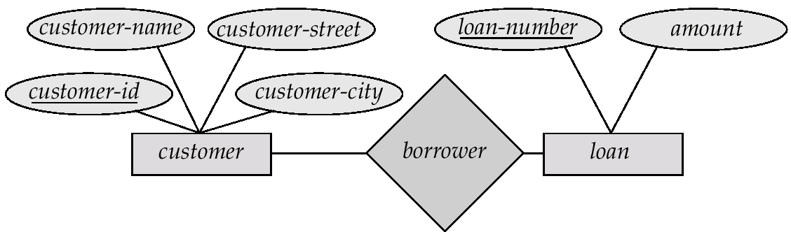
E-R Diagrams
Rectangles represent table sets.
Diamonds represent relationship between tables.
Lines link attributes represent connection between tables with relationship and field.
Ellipses represent table fields
Underline indicates primary key attributes

Slide 2
DBMS | RDBMS
RELATIONSHIP BETWEEN TWO TABLES OR FILES ARE MAINTAINED PROGRAMICALLY | RELATIONSHIP BETWEEN TWO TABLES OR FILE CAN BE SPECIFIED AT THE TIME OF TABLE CREATION
DOES NOT SUPPORT CLIENT /SERVER ARCHITECTURE | SUPPORTS CLIENT/SERVER ARCHITECTURE
DOES NOT SUPPORT DISTRIBUTED DATABSES | SUPPORTS DISTRIBUTED DATABASES
NO SECURITY OF DATA | MULTIPLE SECURITY LEVES; 1 LOGIN AT OS LEVEL 2 COMMAND LEVEL SECURITY 3 OBJECT LEVEL SECURITY
EACH TABLE IS GIVEN EXTENSION | MANY TABLES ARE GROUPED IN ONE DATABASE IN RDBMS
Example :Foxpro | Example : Oracle

Slide 3
SQL VS SQL *PLUS
SQL | SQL *PLUS
SQL is a language for communicating with the oracle server to access data | SQL *PLUS recognizes SQL statements and sends them to Server
SQL is based on American National Standards Institute(ANSI) | SQL *PLUS is the Oracle proprietary interface for execution SQL statements
SQL manipulates data and table definition in the database | SQL *PLUS does not allow manipulation of values in the database
SQL is entered into the SQL buffer on one or more lines | SQL *PLUS is entered one line at a time, not stored in the SQL buffer
SQL does not have continuation character | SQL *PLUS uses a dash(-) as a continuation character if the command is longer than one line
SQL uses a termination character to execute commands immediately | SQL *PLUS does not require termination characters ; executes commands immediately
SQL uses functions to perform some formatting | SQL *PLUS uses commands to format data

